Slide 1
Class-Specific Hough Forests for Object Detection
Juergen Gall¹ and Victor Lempitsky²
¹BIWI, ETH Zurich
¹Max-Planck-Institute for Informatics
²Microsoft Research Cambridge

Slide 2
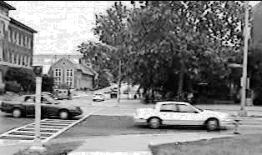
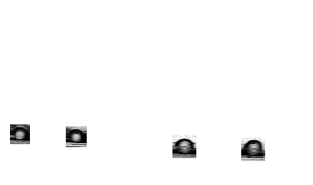
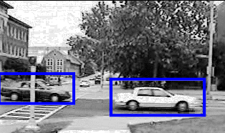
Motivation
Parts of an object provide useful spatial information
Classification of object parts (foreground/background)
Combine spatial information and class information during learning

Slide 3
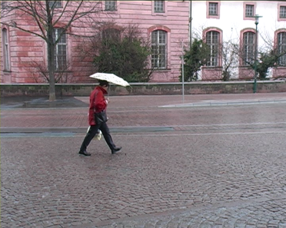
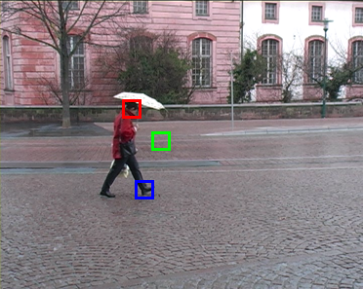
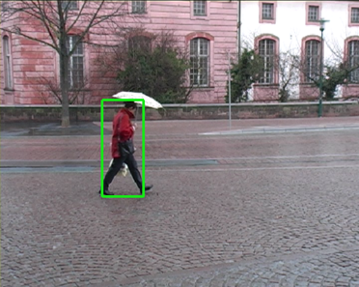
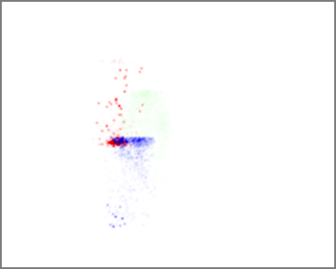
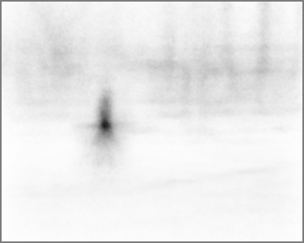
Overview

Slide 4
Related Work
Explicit model of object: Detect parts → Assemble parts together (e.g. Pictorial Structures)
Implicit model of object: Learn relation of parts
Codebook based on appearance (e.g. Leibe et al. IJCV’08)
Codebook based on appearance and spatial information (Opelt et al. IJCV’08; Shotton et al. PAMI’08)
Grid-based classifier for object parts (Winn and Shotton CVPR’06)
Class-specific Hough forest: Generalized Hough transform within Random forest framework (Breiman ML’01)

Slide 5
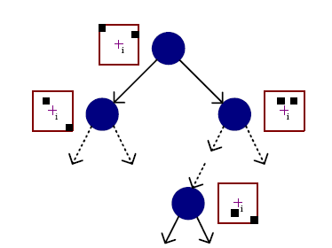
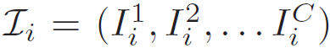
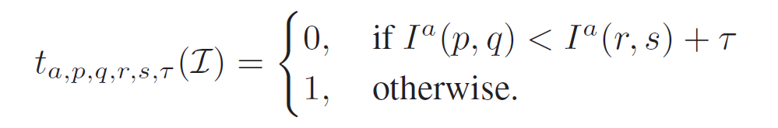
Random Forest
Image patch:
Binary tests:
Binary tests are selected during training from a random subset of all binary tests

Slide 6
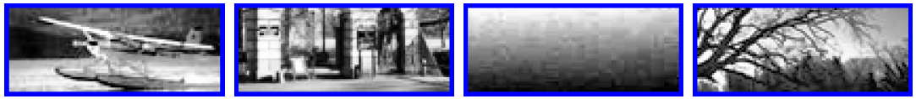
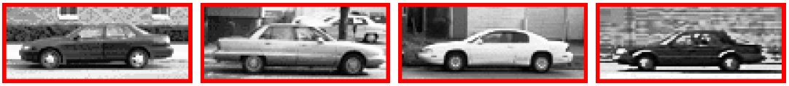
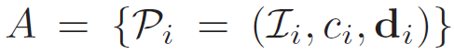
Training
Training set:
Class information: c_{i} (class label)
Spatial information: d_{i} (relative position to object center)

Slide 7
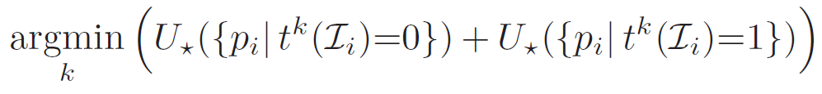
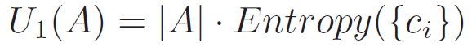
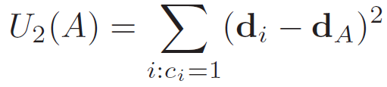
Binary Tests Selection
Test with optimal split:
Class-label uncertainty:
Offset uncertainty:
Interleaved: Type of uncertainty is randomly selected for each node

Slide 8
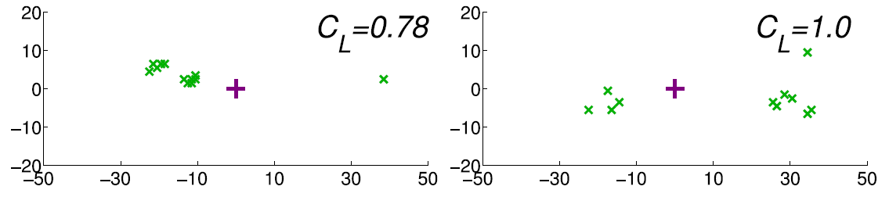
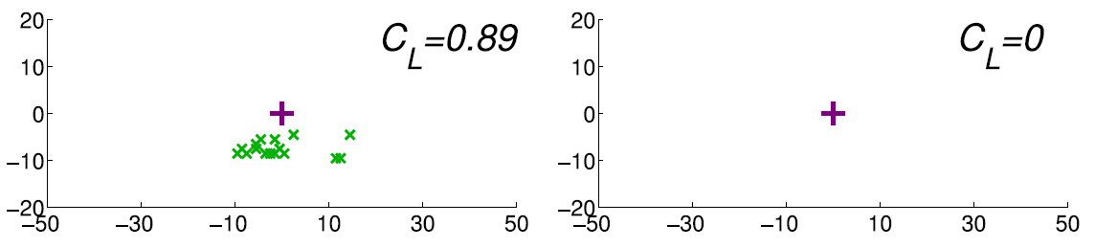
Leaves
Class probability:

Slide 9
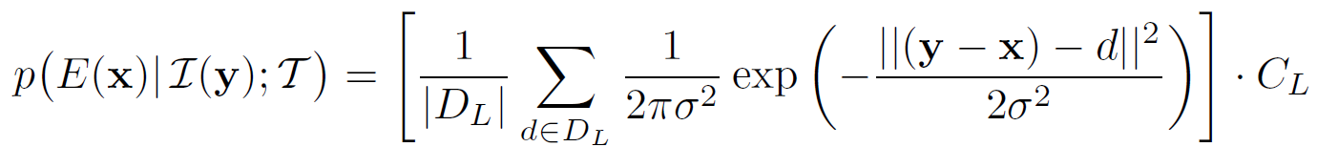
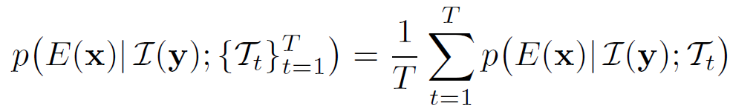
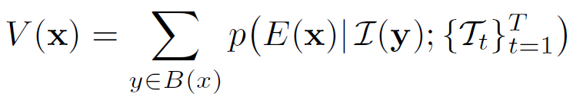
Spatial probability
For location x and given image patch I(y) and tree T
Over all trees:
Accumulation over all image patches:

Slide 10
Detection

Slide 11
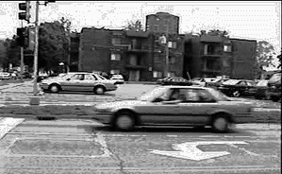
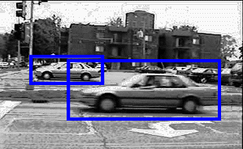



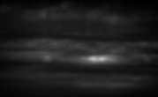

Multi-Scale and Multi-Ratio
Multi Scale: 3D Votes (x, y, scale)
Multi-Ratio: 4D Votes (x, y, scale, ratio)

Slide 12
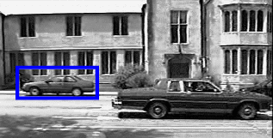
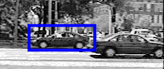
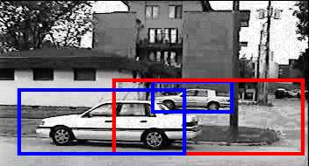
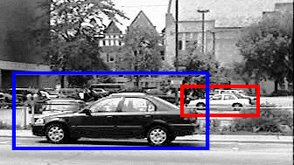
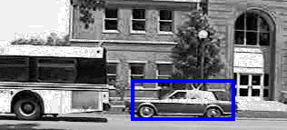
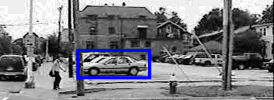
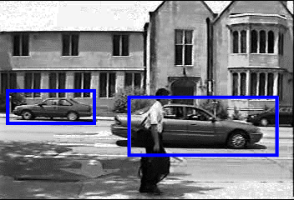
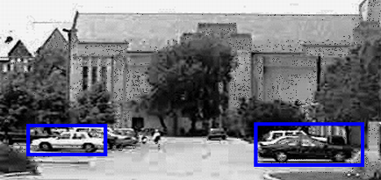
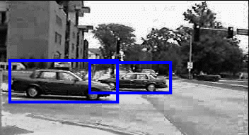
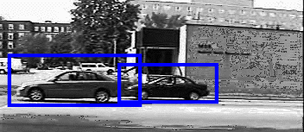
UIUC Cars - Multi Scale
Wrong (EER)
Correct

Slide 13
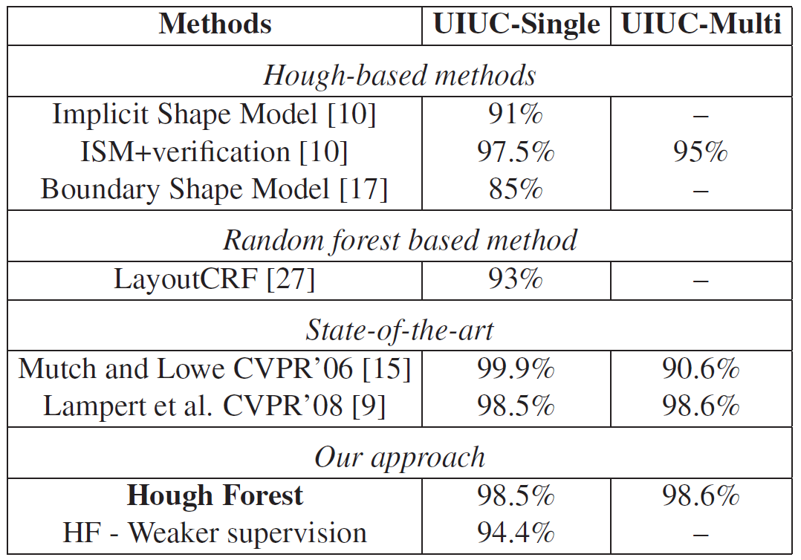
Comparison

Slide 14
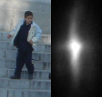
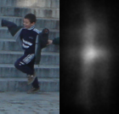
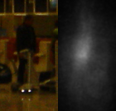
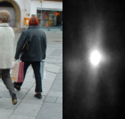
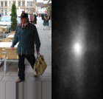
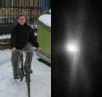
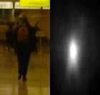
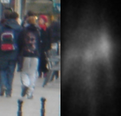
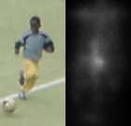
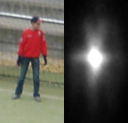
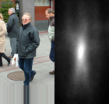
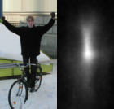
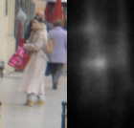
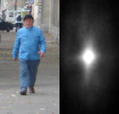




Pedestrians (INRIA)

Slide 15

Pedestrians (INRIA)

Slide 16












Pedestrians (TUD)

Slide 17

Pedestrians (TUD)

Slide 18








Recenter
Object’s center ≠ Centre of bounding box
Split training data → Estimate centers iteratively

Slide 19

Weizmann Horses

Slide 20
Summary
Superior to previous methods using related techniques
State-of-the-art for several datasets
Advantages over related Hough-based methods:
Combine spatial information and class information
No sparse features like SIFT
GPU → real-time performance is feasible
Large and high-dimensional datasets
Bounding box-annotated training data is sufficient
Focus: Get strong signal → Improve Detection
2-class problem → Multi-class problem

Slide 21

Thank you for your attention.
The major part of the research project was undertaken when Juergen Gall was an intern with Microsoft Research Cambridge. The advice from Toby Sharp, Jamie Shotton, and other members of the Computer Vision Group at MSRC is gratefully acknowledged. We would also like to thank all the researchers, who have collected and published the datasets we used for the evaluation.

